Slide 1

The History of Electric Vehicles: From Concept to Modern Innovation
Evolution of EVs from early designs to today
Notes:
AI-generated content may be incorrect. --- Electric vehicles (EVs) have come a long way since their inception. This presentation traces the history of EVs, starting from early concepts and innovations, moving through challenges and competition, to modern advancements and future trends.

Slide 2

Agenda for Discussion
Early Concepts and Inventions
The Rise and Fall in the Early 20th Century
Revival and Technological Advancements
Modern Electric Vehicles
Future Trends and Innovations
Notes:
We will explore the evolution of electric vehicles, beginning with early concepts and inventions that laid the groundwork. Next, we’ll discuss the rise and fall of EVs in the early 20th century, followed by their revival and technological advancements. We will then examine modern electric vehicles and conclude with future trends and innovations in the EV sector.

Slide 3
Early Concepts and Inventions
Notes:
The journey of electric vehicles begins with innovative thinkers and their groundbreaking ideas. Early prototypes laid the foundation for what would become a major technological advancement in transportation.

Slide 4

The First Electric Vehicle Prototypes
Early Development of EVs
The first electric vehicles emerged in the 1830s, showcasing innovative technology powered by non-rechargeable batteries.
Non-Rechargeable Batteries
These early prototypes utilized non-rechargeable batteries, highlighting the limitations and innovations of their time.
Impact on Future Technology
The potential of electric propulsion demonstrated by these prototypes paved the way for advancements in modern electric vehicles.
Notes:
The first electric vehicles appeared in the 1830s, powered by non-rechargeable batteries. These early prototypes demonstrated the potential of electric propulsion, paving the way for future developments in EV technology.

Slide 5

Pioneering Inventors and Their Contributions
Early Electric Motors
The innovations in electric motor design were crucial for the development of efficient electric vehicles, enhancing performance and reliability.
Battery Development
Improvements in battery technology made electric vehicles more practical and accessible, allowing for longer ranges and shorter charging times.
Impact on Transportation
The contributions of early inventors laid the groundwork for modern electric vehicles, changing the face of transportation forever.
Notes:
Inventors like Thomas Parker and Gustave Trouvé played pivotal roles in the development of electric vehicles. Their innovations contributed to the design and efficiency of early electric motors and batteries, pushing the boundaries of what was possible.

Slide 6

Initial Challenges and Limitations
Limited Battery Life
Early electric vehicles struggled with limited battery capacity, leading to shorter driving ranges and frequent recharging needs.
Slow Speeds
The early electric vehicles were often slower than conventional vehicles, which affected their attractiveness to consumers.
Lack of Charging Infrastructure
The absence of adequate charging stations made it challenging for early electric vehicles to gain traction in the market.
Notes:
Despite their promise, early electric vehicles faced significant challenges, including limited battery life, slow speeds, and the lack of charging infrastructure. These limitations hindered widespread adoption during their initial development.

Slide 7
The Rise and Fall in the Early 20th Century
Notes:
The early 20th century saw a brief surge in the popularity of electric vehicles, but shifts in technology and consumer preference led to a significant decline. This section explores the factors influencing this dynamic.

Slide 8

Early Popularity and Adoption
Urban Popularity
Electric vehicles became popular in urban areas due to their quiet operation, making them ideal for city driving.
Market Share in the 1910s
By the 1910s, electric vehicles held a significant share of the automotive market, especially among city dwellers.
Ease of Use
The simplicity and convenience of electric vehicles made them appealing to everyday drivers in urban settings.
Notes:
Electric vehicles gained popularity in urban areas for their quiet operation and ease of use. By the 1910s, EVs accounted for a notable percentage of the automotive market, appealing to city dwellers.

Slide 9
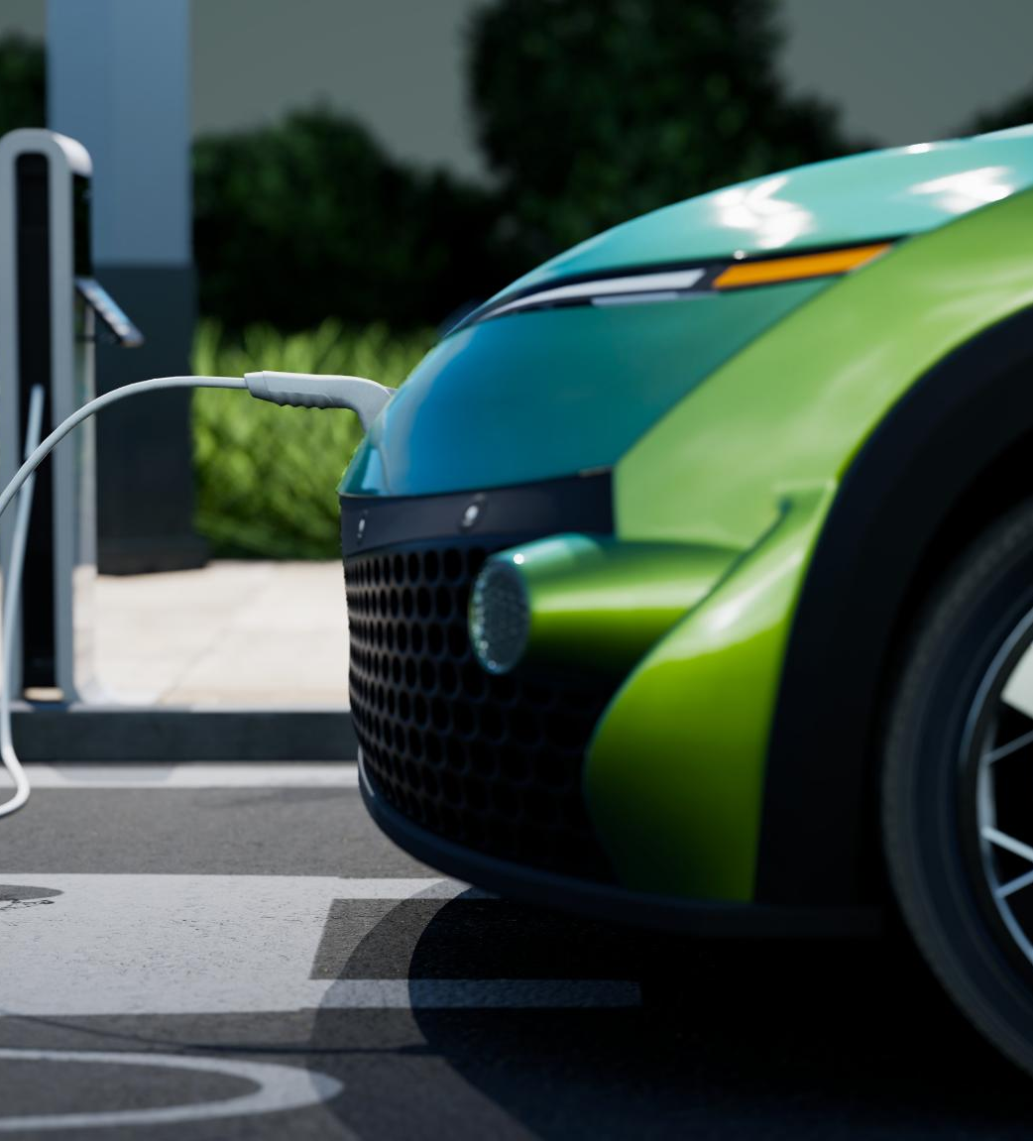
Competition with Gasoline-Powered Cars
Rise of Gasoline Vehicles
Gasoline-powered vehicles quickly gained popularity due to their greater range and speed compared to earlier models.
Internal Combustion Innovations
Innovations in internal combustion engines enhanced the performance of gasoline vehicles, making them more appealing to consumers.
Impact on Electric Vehicles
The advancements in gasoline technology reduced the competitiveness of electric vehicles in the automotive market.
Notes:
The advent of gasoline-powered vehicles, which offered greater range and speed, led to fierce competition. Innovations in internal combustion engines further diminished the appeal of electric vehicles.

Slide 10

Decline in Interest and Production
Shift to Gasoline Cars
In the 1930s, manufacturers increasingly prioritized gasoline cars, leading to a significant decline in electric vehicle production.
Infrastructure Development
The expansion of gas station infrastructure made gasoline cars more accessible, further diminishing interest in electric vehicles.
Declining Electric Vehicle Appeal
As gasoline vehicles became more popular, electric vehicles lost their appeal due to limited availability and infrastructure support.
Notes:
By the 1930s, the decline in interest for electric vehicles was evident as manufacturers focused on gasoline cars. Factors such as improved infrastructure for gas stations contributed to this trend.

Slide 11
Modern Electric Vehicles
Notes:
Today, electric vehicles are more popular than ever, with numerous manufacturers producing a variety of models. This section covers the key players in the market and the enhancements that make EVs appealing to consumers.

Slide 12
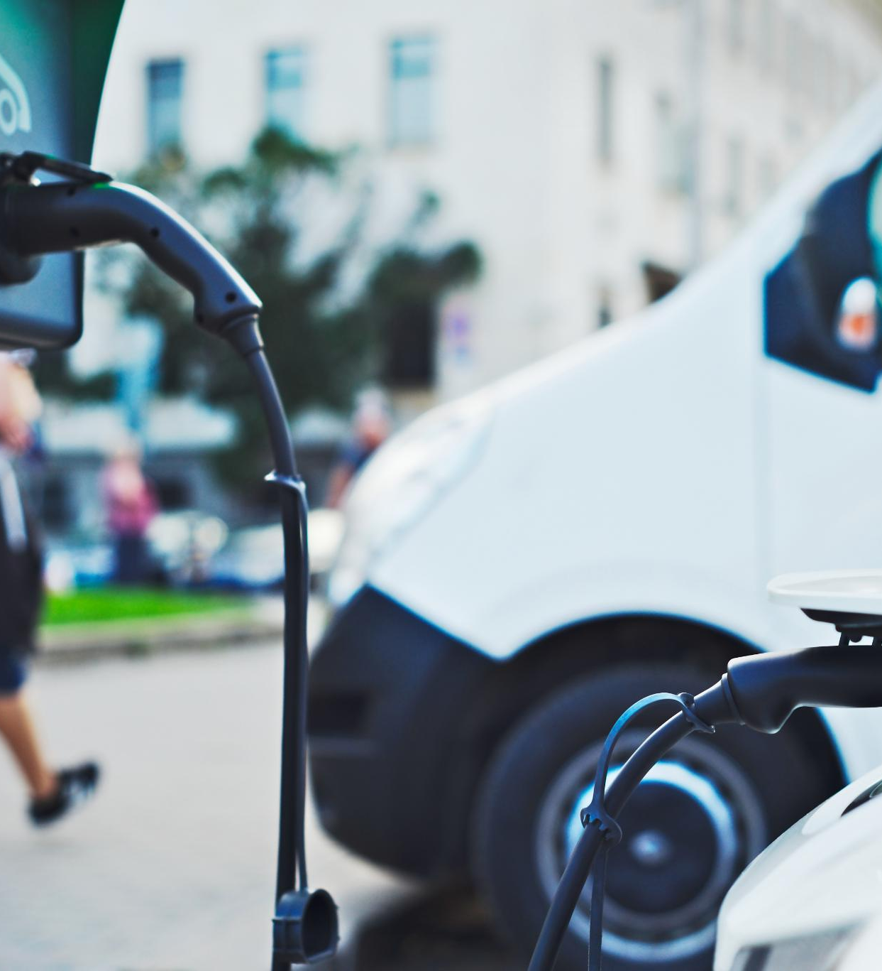
Major Manufacturers and Models
Electric Vehicle Leadership
Tesla, Nissan, and Chevrolet lead the electric vehicle market with innovative models catering to various needs.
Diverse Model Range
These manufacturers offer a range of models from affordable compact cars to luxury sedans, satisfying diverse consumer preferences.
Catering to Consumers
The variety in electric vehicles ensures that all consumers, regardless of budget, can find an option that suits their needs.
Notes:
Companies like Tesla, Nissan, and Chevrolet have emerged as leaders in the electric vehicle market, offering models that range from affordable compact cars to luxury sedans. The variety caters to a wide range of consumers.

Slide 13
Performance Improvements and Features
Rapid Acceleration
Electric vehicles are designed for rapid acceleration, providing a thrilling driving experience and quick responsiveness on the road.
Regenerative Braking
Regenerative braking in electric vehicles recovers energy during braking, enhancing efficiency and extending driving range.
Smart Connectivity
Advanced technology features such as smart connectivity provide seamless integration with devices, enhancing user experience and convenience.
Notes:
Modern electric vehicles boast impressive performance metrics, including rapid acceleration and advanced technology features such as regenerative braking and smart connectivity, enhancing the driving experience.

Slide 14
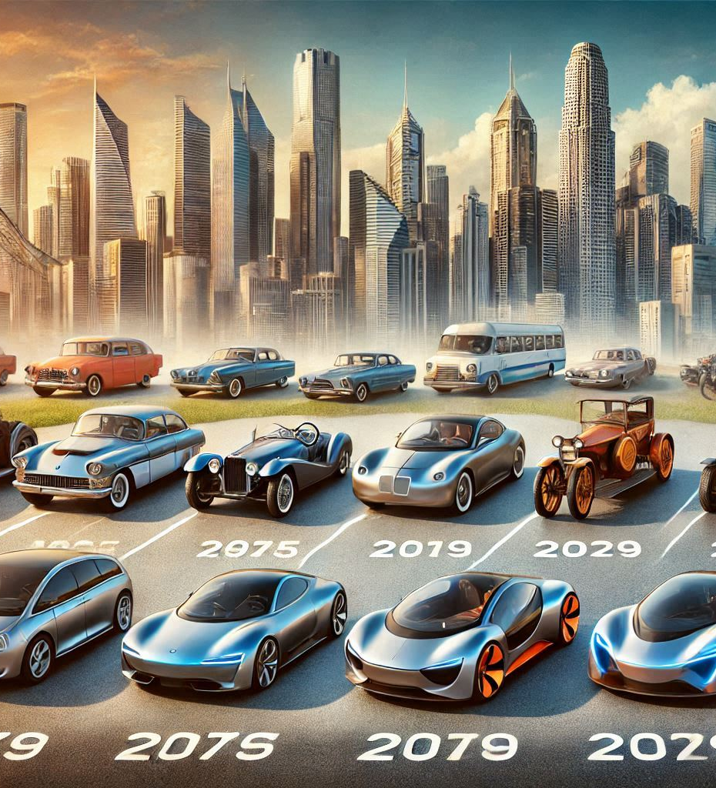
Market Growth and Consumer Adoption
Rapid Market Growth
The electric vehicle market has seen significant growth due to technological advancements and supportive policies.
Consumer Awareness
Growing consumer awareness about the benefits of electric vehicles is driving market acceptance and demand.
Long-Term Benefits
Consumers are increasingly recognizing the long-term benefits of electric vehicles, such as cost savings and environmental impact.
Notes:
The electric vehicle market has experienced rapid growth in recent years, with increasing consumer awareness and acceptance. More people are recognizing the long-term benefits of going electric, leading to rising sales figures.

Slide 15
Future Trends and Innovations
Notes:
Looking ahead, the electric vehicle industry is poised for further transformation. This section discusses anticipated trends and innovations that will shape the future of transportation.

Slide 16
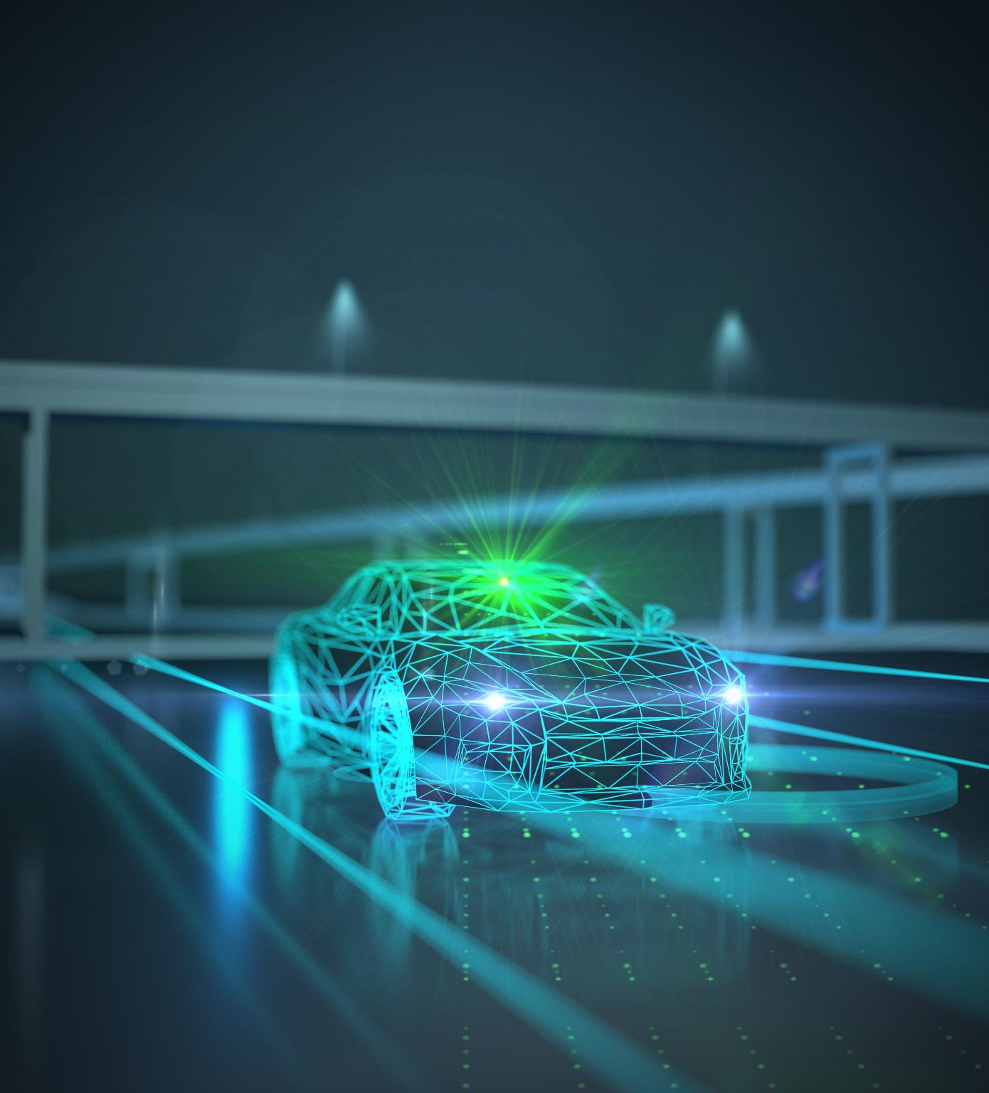
Autonomous Electric Vehicles
Revolutionizing Transportation
The integration of autonomous technology into electric vehicles promises to transform transportation by enhancing safety and efficiency.
Enhanced Safety Features
Autonomous electric vehicles come equipped with advanced safety technologies that reduce accidents and improve overall road safety.
Changing Perceptions of Mobility
This innovation could significantly alter how we perceive mobility, making transportation more accessible and efficient for everyone.
Notes:
The integration of autonomous technology into electric vehicles has the potential to revolutionize transportation, offering greater safety and efficiency. This innovation could change how we perceive mobility.

Slide 17
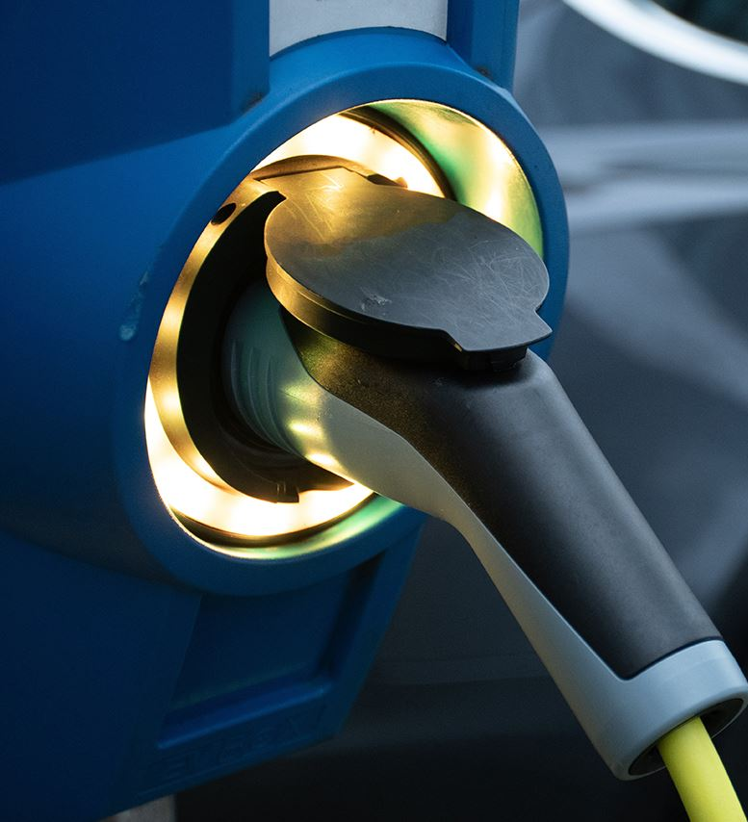
Charging Infrastructure Advancements
Growing Demand for EVs
The increasing popularity of electric vehicles necessitates a reliable and extensive charging infrastructure to meet consumer needs.
Fast Charging Technologies
Advancements in fast charging technologies allow for quicker vehicle charging times, enhancing convenience for users.
Wireless Charging Innovations
Wireless charging technology is emerging as a convenient solution for electric vehicle users, eliminating the need for cables.
Notes:
As the demand for electric vehicles grows, so does the need for robust charging infrastructure. Advances in charging technologies, including fast charging and wireless charging, are essential to support widespread EV adoption.

Slide 18

Sustainability and Environmental Impact
Reduction of Greenhouse Emissions
Electric vehicles are considered a vital solution to reduce greenhouse gas emissions and combat climate change effectively.
Sustainability in Production
Future innovations will enhance the sustainability of electric vehicle production, focusing on eco-friendly materials and processes.
Environmental Impact of Batteries
Addressing the environmental impact of battery manufacturing is essential for the overall sustainability of electric vehicles.
Notes:
Electric vehicles are often viewed as a solution to reduce greenhouse gas emissions. Future innovations will focus on enhancing the sustainability of EV production and addressing the environmental impact of battery manufacturing.

Slide 19
Revival and Technological Advancements
Notes:
The late 20th century marked a revival of interest in electric vehicles, driven by environmental concerns and advancements in technology. This segment explores the factors that reignited the EV movement.

Slide 20
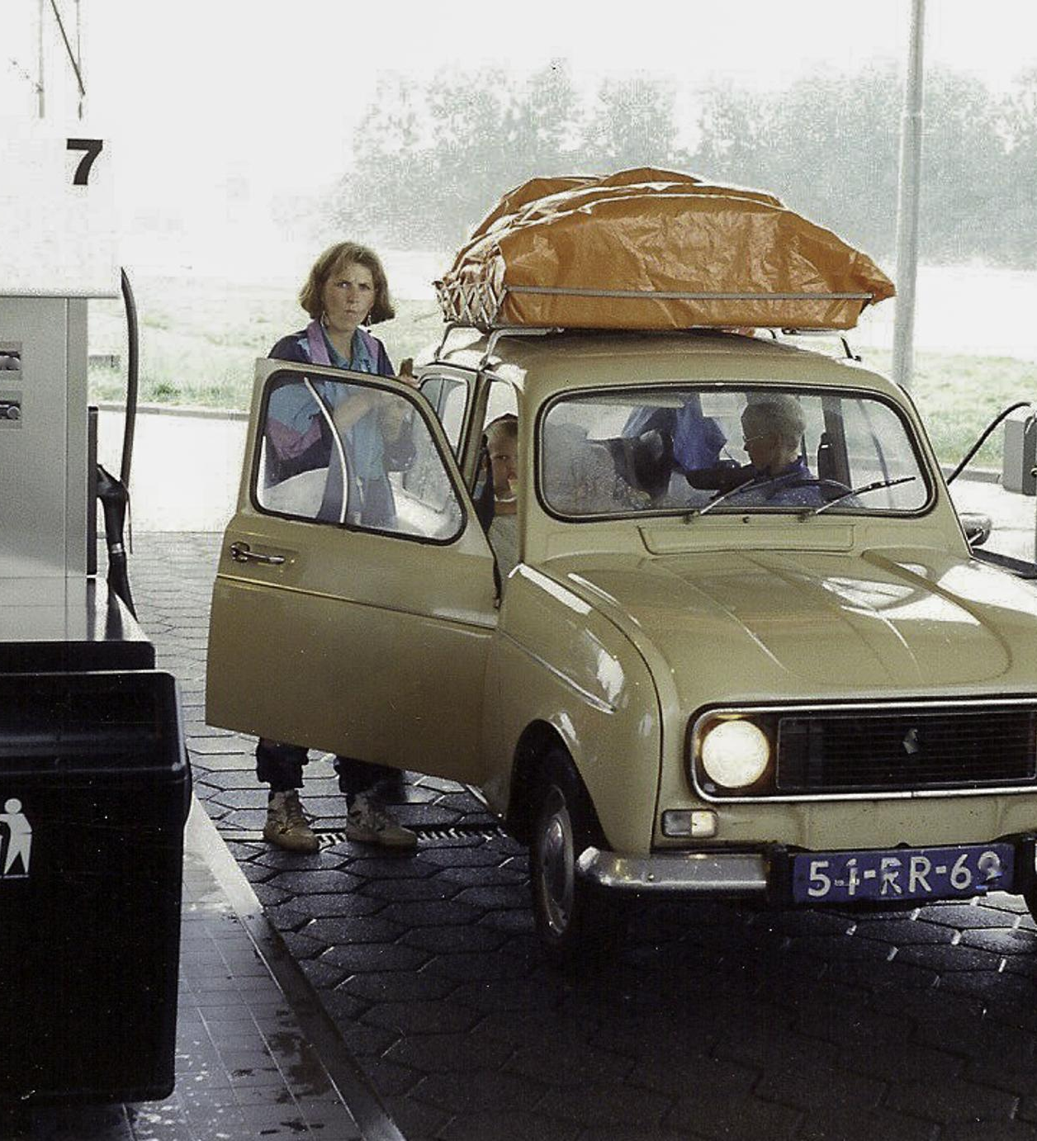
Environmental Awareness and Fuel Crises
Rise of Environmental Awareness
The 1970s saw a surge in environmental awareness, leading to increased public concern over pollution and ecological impacts.
Fuel Crises Impact
The fuel crises of the 1970s highlighted issues of oil dependency, driving consumers to seek alternative energy sources.
Electric Vehicle Interest
As a sustainable alternative, electric vehicles gained renewed interest, aiming to reduce reliance on fossil fuels.
Notes:
Growing environmental awareness and fuel crises in the 1970s prompted renewed interest in electric vehicles as a sustainable alternative to fossil fuels. Public concern over pollution and oil dependency fueled demand.

Slide 21
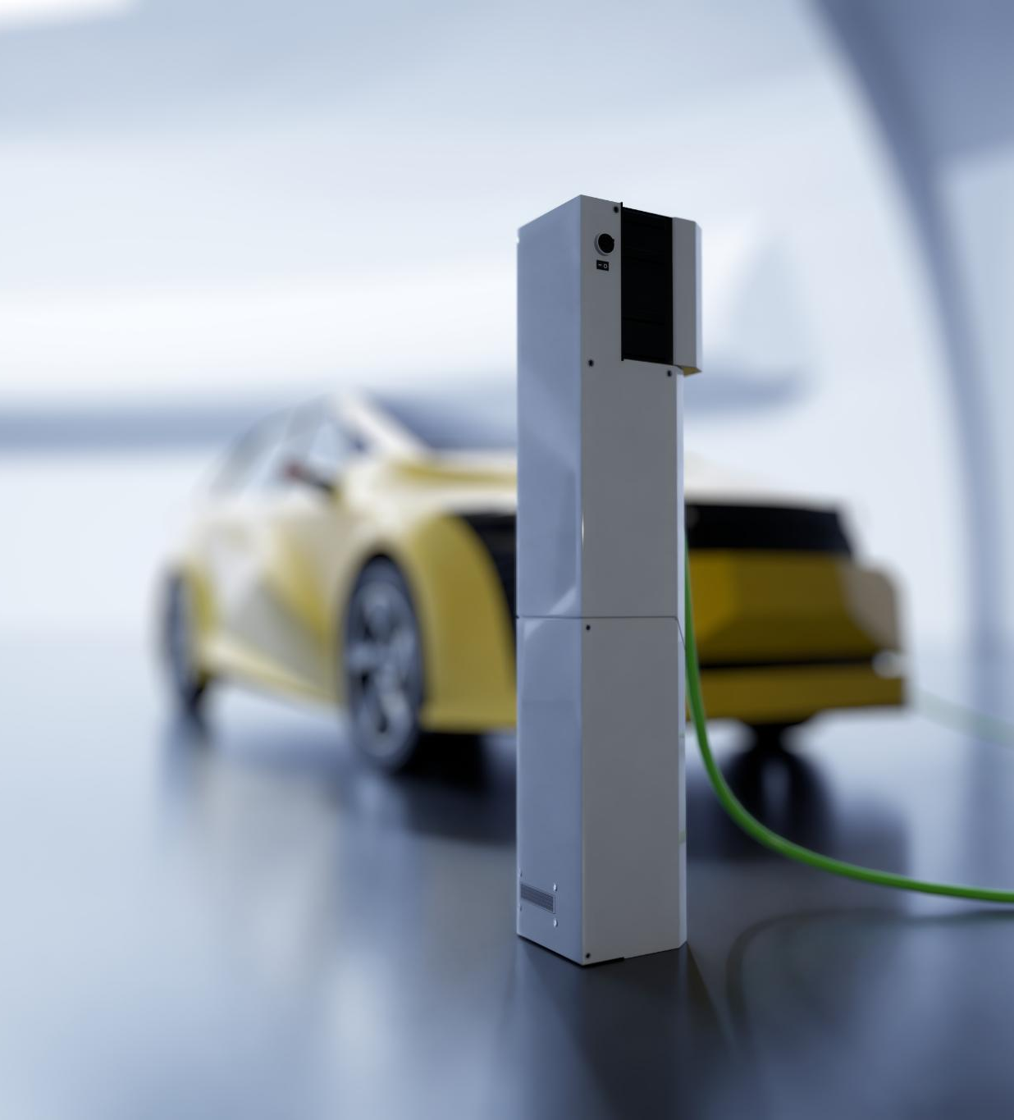
Advancements in Battery Technology
Lithium-Ion Batteries
The development of lithium-ion batteries has revolutionized energy storage, greatly enhancing battery performance and efficiency.
Impact on Electric Vehicles
Advancements in battery technology have significantly improved the range and performance of electric vehicles, making them more appealing to consumers.
Notes:
Significant breakthroughs in battery technology, especially the development of lithium-ion batteries, have drastically improved the performance and range of electric vehicles, making them more viable for consumers.

Slide 22
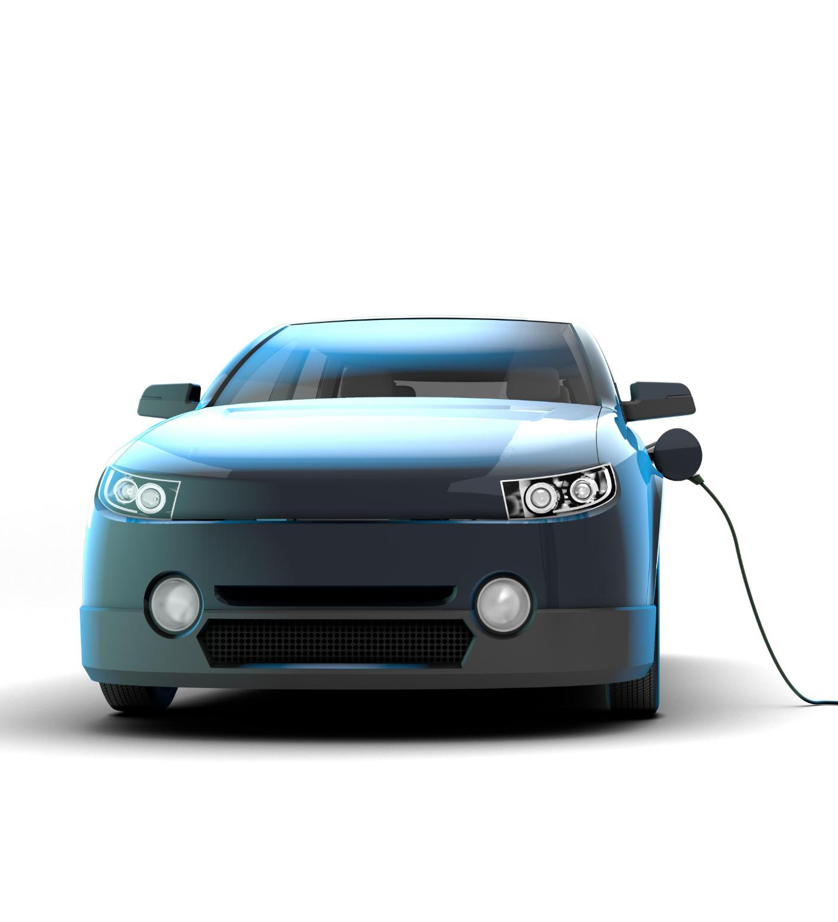
Government Policies and Incentives
Incentives for Electric Vehicles
Governments offer tax credits and subsidies to encourage the purchase of electric vehicles, making them more accessible to consumers.
Charging Infrastructure Investments
Investment in charging infrastructure is critical for supporting electric vehicle adoption and ensuring convenient access for users.
Market Growth Stimulation
Government policies and incentives significantly stimulate the growth of the electric vehicle market, attracting more manufacturers and consumers.
Notes:
Governments worldwide began to implement policies and incentives to promote the adoption of electric vehicles, including tax credits, subsidies, and investments in charging infrastructure, further stimulating market growth.

Slide 23
Conclusion
Journey of Innovation
The evolution of electric vehicles showcases remarkable innovations that have transformed transportation over the decades.
Challenges Faced
Electric vehicles faced numerous challenges, including battery technology, range anxiety, and infrastructure development, impacting their adoption.
Future of Sustainable Transportation
With ongoing advancements, electric vehicles are poised to lead the charge towards a more sustainable and eco-friendly transportation future.
Notes:
The history of electric vehicles reflects a journey of innovation, challenges, and resurgence. As technology continues to evolve, electric vehicles are set to play a crucial role in the future of sustainable transportation.

